Slide 1
BLOCK-CHAIN BASED CERTIFICATE VALIDATION
PIP104 PROFESSIONAL PRACTICE-II
VIVA-VOCE
Batch Number: CSE-G166
Roll Number | Student Name
20201CSE0857 | VRUSHANK RAO
20201CSE0856 | VINAY KUMAR M
20201CSE0885 | K C SRI VENKATESH
Under the Supervision of,
Dr.Pamela Vinitha Eric
Professor
School of Computer Science Engineering & Information Science
Presidency University

Slide 2
Introduction
These crucial credentials are important to a person's life, and sharing and issuing them must be done in a safe and effective manner. These important documents can have a safe and unchangeable solution with blockchain technology, guaranteeing their reliability and value for the duration of a person's life.
To increase the security of issued certificates, educational institutions must assign a unique identification number, attach a distinguishable hologram, attach a passport photo of the student, and provide student information such as date of birth, place of birth, and address. Using various methods, such as printing detailed information.
Additionally, during the hiring process, companies should also review the references they receive directly from candidates. Companies often contact parent institutions to verify the credentials received from applicants. Such a process is labor-intensive, costly, and time-consuming. Some of the recent publications outline the benefits and challenges of using blockchain technology in education. However, there is still a need to develop a working prototype of a degree-sharing platform that can serve all stakeholders in the education ecosystem. safely and effectively

Slide 3
Literature Review
Title | Author(s) | Publication Year | Methodology | Findings | Key Contributions
Blockchain for Certificate Verification: A Review | Sharma, A., & Gupta, R. | 2020 | Literature Review | Identified the potential of blockchain in enhancing certificate verification, ensuring transparency, and reducing fraud. | Explores the existing challenges in traditional certificate validation systems and how blockchain can address these challenges.
A Decentralized Framework for Certificate Authentication using Blockchain | Chen, L., & Wang, Y. | 2018 | Proposed Framework | Introduced a decentralized framework using blockchain for certificate authentication, emphasizing on security and immutability. | Presents a conceptual framework that utilizes blockchain's features to create a tamper-proof and transparent certificate validation system.
Blockchain Technology for Educational Credential Verification | Smith, J., & Jones, M. | 2019 | Case Study & Survey | Examined the use of blockchain for educational credential verification through a case study and a survey of educational institutions. | Provides insights into the practical implementation of blockchain in educational settings and gauges the perception of stakeholders.
Smart Contracts for Automated Certificate Validation | Kim, S., & Lee, H. | 2021 | Experimental Study & Simulation | Investigated the use of smart contracts to automate the certificate validation process and evaluated the performance through simulations. | Demonstrates the efficiency gains and automation capabilities achieved by integrating smart contracts into certificate validation processes.
Enhancing Trust in Certificates through Blockchain Technology | Patel, A., & Kumar, S. | 2017 | Conceptual Framework | Proposed a conceptual framework for enhancing trust in certificates using blockchain technology, emphasizing transparency and security. | Presents a theoretical model for leveraging blockchain to establish trust in certificate validation systems and prevent fraudulent activities.

Slide 4
Research Gaps Identified
Regulatory Compliance:
Research Gap: The regulatory status of certificates varies by region. Research is needed to address regulatory compliance challenges and ensure that blockchain-based verification systems meet regulatory standards and requirements.
Smart Contract Security:
Research Gap: Smart contracts are an important part of blockchain-based certificate validation projects. Research is needed to improve the security of smart contracts, reduce vulnerabilities, and ensure the integrity of the validation process.
Energy Efficiency:
Research Gap: Some blockchain networks, especially those using proof-of-work consensus mechanisms, have been criticized for their environmental impact due to high energy consumption. Research is needed to explore and implement more energy-efficient consensus mechanisms in certificate validation projects.
Standardization of data formats:
Research gap: Lack of standardized data formats for certificates can impact interoperability. Research should focus on proposing and adopting standardized data formats that enable seamless communication between different blockchain-based systems.

Slide 5
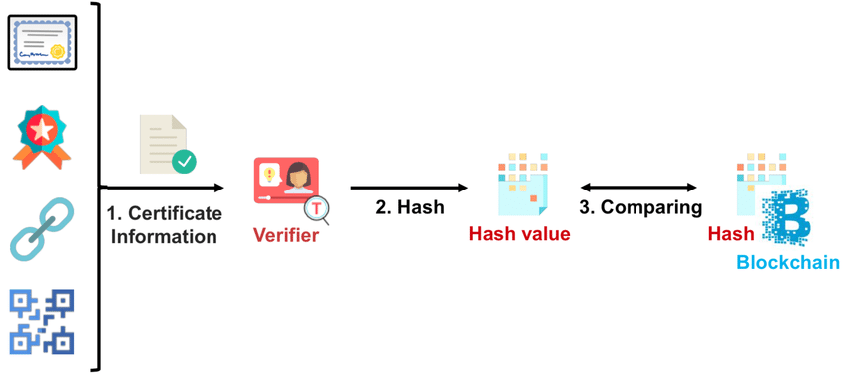
Proposed Methodology

Slide 6
Proposed Methodology
Name:
Refers to the name of the certificate owner. We are inserting a field in the certificate data structure to store the name of the person who purchases a certificate. This part of the information becomes the transaction recorded on the blockchain.
Course:
Specifies the course or program for which the certificate is awarded. It creates a field in the certificate data structure to store course details. This field contains information such as course name, duration, and other relevant details.
Certificate Hash:
We use cryptographic hashes of certificate data to ensure data integrity. Create a unique identifier by generating a hash (e.g.SHA-256) of the entire certificate data, including name, course, issuing organization, and other relevant details. Storing this hash on the blockchain ensures that the record is tamper-proof. It is important to note that any changes to the certificate data will generate a different hash, highlighting potential tampering attempts.
Certificate ID:
Each certificate requires a unique identifier to facilitate search and verification. To address this issue, we assign a unique certificate ID to each certificate at the time of issuance. This unique ID becomes an integral part of the blockchain record, ensuring easy search and quick verification.

Slide 7
Objectives
Building a blockchain-based certificate validation project means leveraging a decentralized and tamper-proof nature of blockchain technology to ensure the authenticity and integrity of certificates. Below describe the objectives of the project:
[1] Create a blockchain-based decentralized application (D App) for the verification and issuance of educational certificates.
[2] Eliminate all third-party interference in the verification process.
[3] To reduce the cost and time of the validation process.
[4] To protect the certificate validation and issuance process from fraud and fraudsters.
[5] Make documents tamper-proof and instantly verifiable on the blockchain.
[6] To provide benefits to students, educational institutions, and employers using blockchain-based certificate verification systems.
[7] Implement blockchain mechanisms to minimize document verification time.
[8] Development of a certificate verification application that implements the concept of public blockchain.
[9] Integrate blockchain functionality into the document verification process of the verification system to reduce time complexity.
[10] To improve the efficiency of certificate validation and traditional approaches.
[11] The main goal of our system is to implement document sharing and validation without increasing administrative costs. It also prevents document forgery and provides accurate and reliable information about digital certificates.

Slide 8
System Design & Implementation
This system is designed to verify diplomas and other documents. This system includes three functions.
USER1: User 1 is the author/university. This user will generate and issue all certificates for students. First, the eligibility of the students is checked, then the certificate is generated, and the hash of the certificate is calculated and uploaded to the blockchain.
User 1 generates and views the student’s certificate.
User 2: User 2 is a student/document owner. This user is eligible to take the exam and will receive a certificate from User 1. User 2 makes two decisions: User 2 uses the user ID to share the certificate with other users and to view the certificate. Upload user 1’s certificate.
User 3: User 3 is an authenticated third party/company. This user receives a copy of the latest document from User 2 and needs to review it from User 1. User 3 requests a certificate from User 1 and User 2 and shares the certificate.

Slide 9
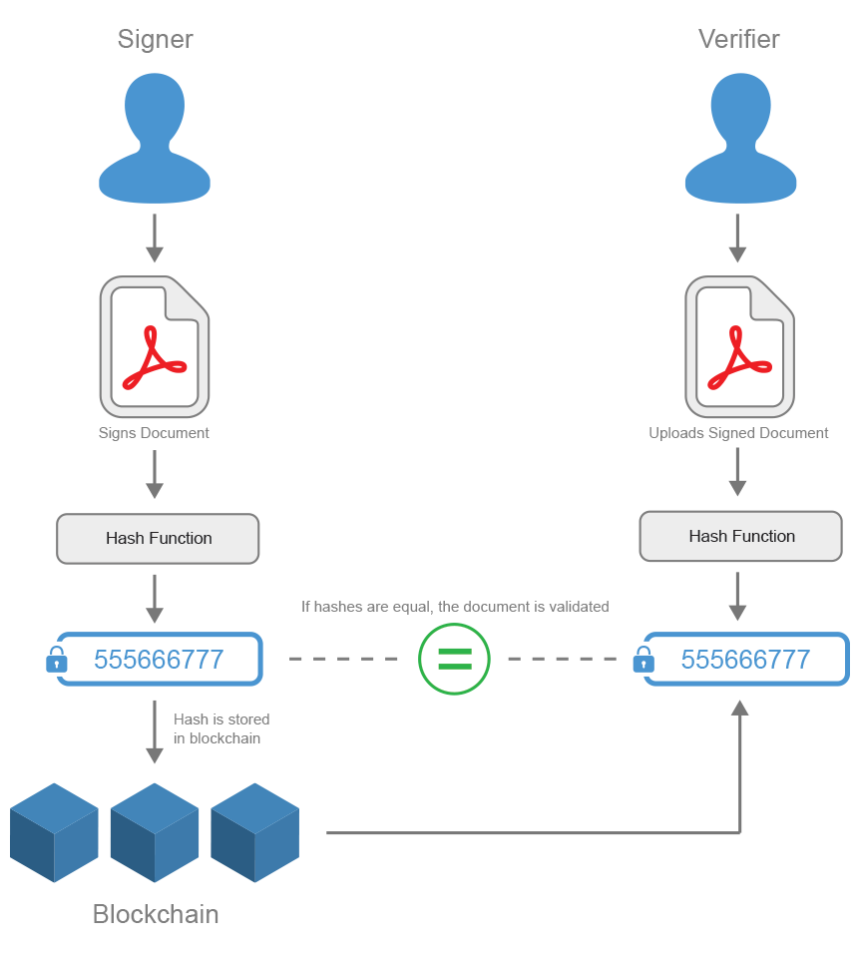
System Design & Implementation

Slide 10
Implementation
Frontend:
HTML (Hyper Text Markup Language): Used to structure web content.
Define the basic structure of your website.
CSS (Cascading Style Sheets): Used to style and display HTML elements.
Define the layout, colors, and styles of your web pages.
JS (JavaScript): Used to add interactivity to web pages.
Enable dynamic content, form validation, and asynchronous communication.
Backend:
SMTP (Simple Mail Transfer Protocol): The protocol used to send and receive email.
In this context, it may be used to handle email functions such as sending confirmation emails or notifications.
PHP: Server-side scripting language.
It is used to process data, interact with databases, and generate dynamic content on the server.
SQL (Structured Query Language): A language for managing and editing relational databases.
Used in conjunction with a database management system.
Examples: MySQL, PostgreSQL.
For data storage and retrieval.

Slide 11

Timeline of Project

Slide 12
Outcomes / Results Obtained
Improved security:
Results: Implementing cryptographic hashing and distributed storage on top of the blockchain ensures a high level of security. The tamper-proof nature of blockchain technology greatly reduces the risk of unauthorized access, data manipulation, and fraud.
Transparent and tamper-proof record:
Results: Storing certificate details on the blockchain creates a transparent and tamper-proof record. Once obtained, certificates cannot be changed, making them an immutable source of truth for verification.
Efficient Certificate Verification:
Results: Blockchain-based systems streamline the certificate verification process, making it more efficient for both certificate holders and verifiers. Users can easily present their credentials, and verifiers can quickly and reliably authenticate certificates by referencing the blockchain.
User empowerment and privacy:
Results: Users with certificates experience greater control and ownership over their credentials. Secure username and password authentication combined with encryption technology ensures user privacy and protects sensitive information within the certificate.
Global Recognition and Standardization:
Results: Adhering to standardized data formats and leveraging blockchain transparency will improve global recognition of certificates. The system supports international educational standards and facilitates the acceptance and validation of educational qualifications across borders.
Reducing Fraud and Manipulation:
Results: The use of blockchain technology significantly reduces the risk of credential fraud. A distributed, tamper-proof ledger makes it difficult for malicious attackers to manipulate or forge certificates.

Slide 13
Conclusion
technology can eliminate the issue of forged or lost certificates. Check your certificates anytime, anywhere. This application provides accurate and reliable information about digital certificates. A blockchain-based certificate validation project includes key elements such as name, course, issuing organization, certificate hash, etc., and issues security, reliability, and efficiency in the certificate validation process. Provides a robust solution to address By using decentralized blockchain technology, this project ensures the integrity and immutability of certificates, thereby significantly reducing the risk of fraud.
Certificate ID allows you to quickly and reliably retrieve certificate details, simplifying the verification process for various parties. A cryptographic hash of the certificate content provides a tamper-proof mechanism that enhances the overall security of the system. This innovative approach not only minimizes dependence on central authorities but also promotes transparency and trust in validating education and training qualifications. As projects evolve, collaboration with stakeholders, compliance with regulatory standards, and a focus on user-friendly interfaces will be essential to widespread adoption and success in the certificate validation space.

Slide 14
References
TamperProofBirthCertificateUsingBlockchainTechnology", International Journal of Recent Technology and Engineering (IJRTE), Volume 7[1].
Blockchain-Based Identity Verification Model", International Conference on Emerging Trends in Communication and Networking (ViTECoN)[2].
Maharshi Shah, Priyanka Kumar, “Tamper Proof Birth Certificate Using Blockchain Technology”, International Journal of Recent Technology and Engineering (IJRTE), Volume-7, Issue-5S3, February 2019[3].
Emmanuel Nyaletey, Reza M. Parizi, Qi Zhang, Kim-Kwang Raymond Choo, “BlockIPFS - Blockchain-enabled Interplanetary File System for Forensic and Trusted Data Traceability”, IEEE International Conference on Blockchain, 2021[4].

Slide 15
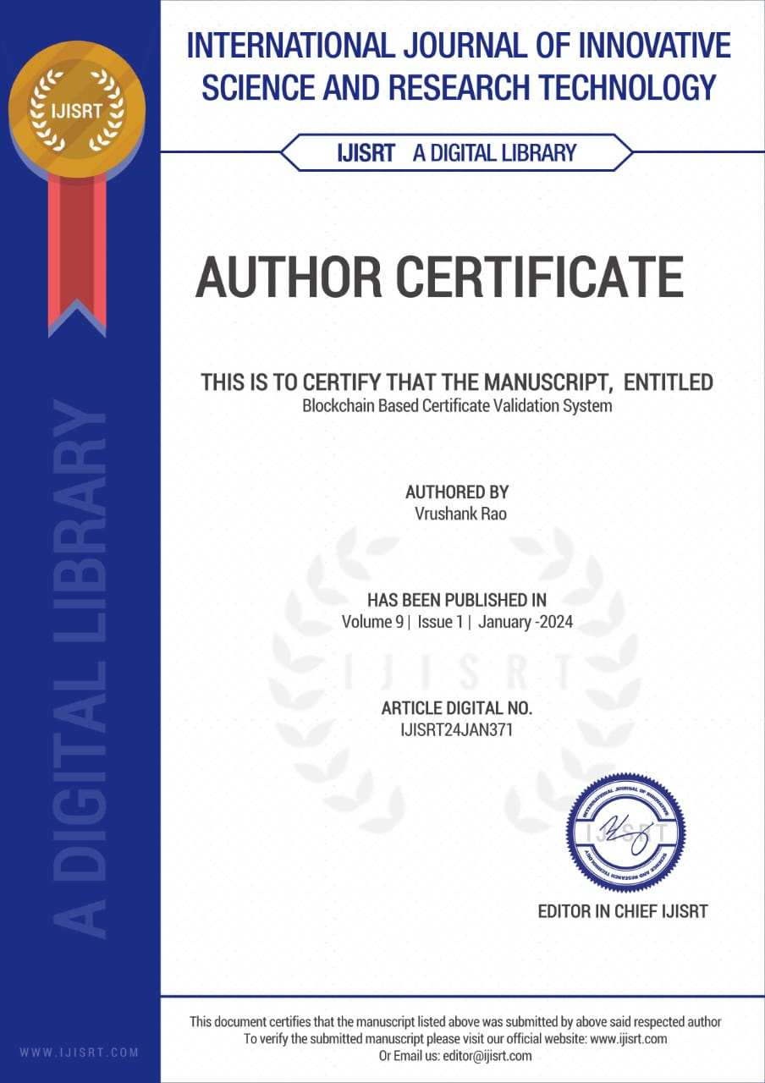


Publication Details

Slide 16

Thank You

